Slide 1
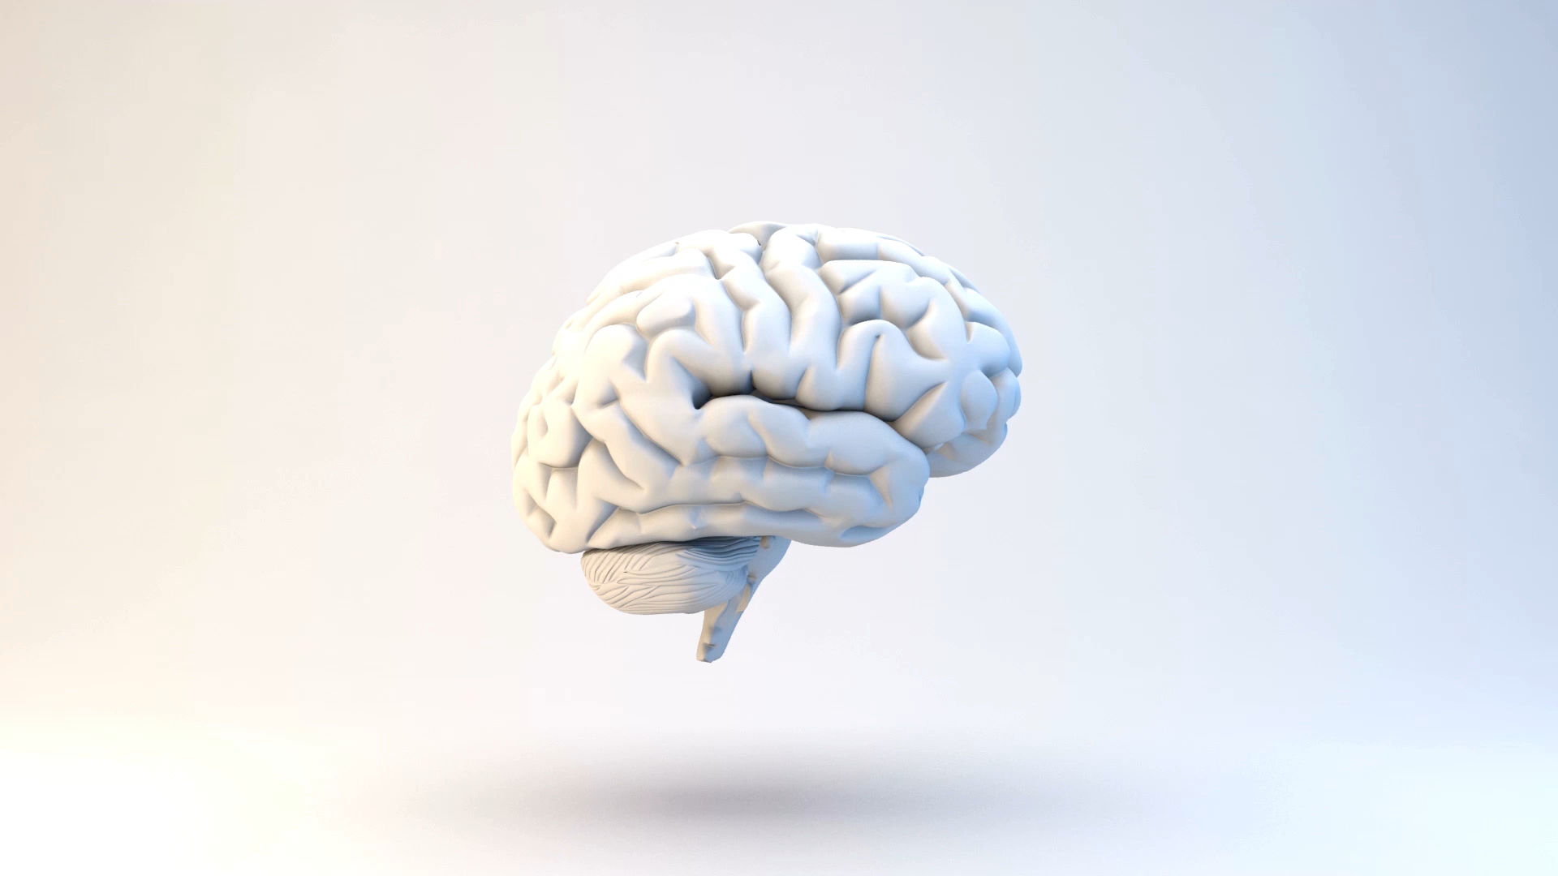
Evaluating (and Improving) the Correspondence Between Deep Neural Networks and Human Representations

Slide 2

Joshua C. Peterson, Joshua T. Abbott, Thovmas L. Grifﬁths (P.A.G)
(w/ graphics from Ayşe Aybüke Durmaz, Homa Priya Tarigopula)

Slide 3
P.A.G Project Overview
Introduction
Aims
Evaluating the correspondence between representations
Stimuli, Methods, Results, Analysis

Slide 4

Reweighting starts like RSA
Comparing the representations formed by deep neural networks to those of humans.
Human representation:
Similarity judgments.
A similarity function over a set of pairs of data points corresponds to an implicit representation of those points

Slide 5
Evaluating the correspondence between representations
Obtain the similarity within images using human ratings
Find the similarity within images of each category by
Studying Raw representations of DNNs
Studying Transformed Representations of DNNs
Probe both DNN and human similarities to identify the spatial and taxonomic information encoded
MDS, HCA

Slide 6
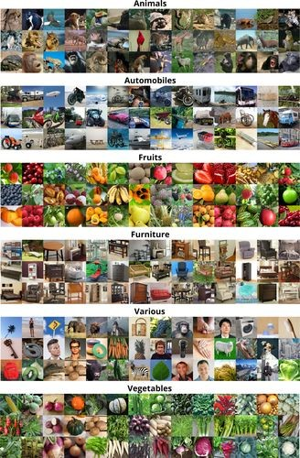
Evaluating the correspondence between representations
Stimuli
6 categories - 120 images each
Procedures:
pairwise image similarity ratings
Amazon Mechanical Turk
0 (“not similar at all”)
10 (“very similar”)
six 120x120 similarity matrices

Slide 7
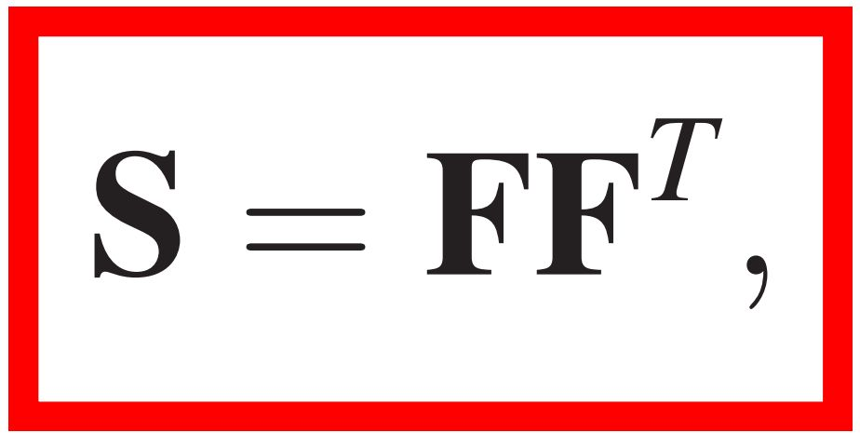
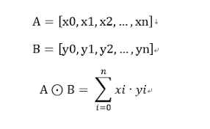
Evaluating the correspondence between representations
SIMILARITY MATRIX from humans
FEATURE MATRIX (dot product/ R/ cosine)

Slide 8
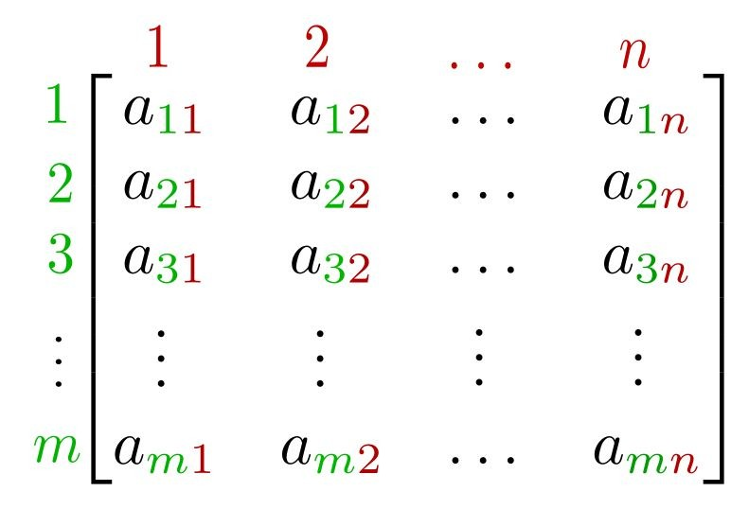
Evaluating the correspondence between representations
Deep neural network representations :
When deep neural networks are presented with an image, the nodes that comprise the network obtain different activation values.
Multidimensional feature representation
FEATURE MATRIX
120 images

Slide 9
Evaluating the correspondence between representations
How to extract deep feature representations??
4 highly popular convolutional neural network image classifiers
AlexNet
VGG
GoogLeNet
ResNet
FEATURE MATRIX

Slide 10
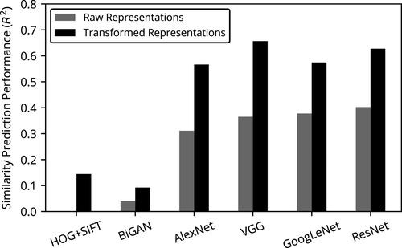
Comparing networks
Most classification networks perform similarly, yet VGG is slightly better on average.

Slide 11
Evaluating the correspondence between representations
How to extract deep feature representations??
4 highly popular convolutional neural network image classifiers
AlexNet
VGG
GoogLeNet
ResNet
Extract only the activations at the final hidden layer of each network.
FEATURE MATRIX

Slide 12
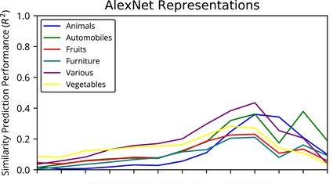
Comparing networks
They examined performance at each layer of the network, including final class probabilities and discrete labels.
Performance climbs as the depth of the network increases, but falls off near the end when the final classification outputs near.

Slide 13
Layers of networks
For all datasets, the best layer was the final hidden layer, as opposed to the classification layer.
This indicates that relatively high-level, yet non-semantic information is most relevant to the human judgments we obtained.

Slide 14
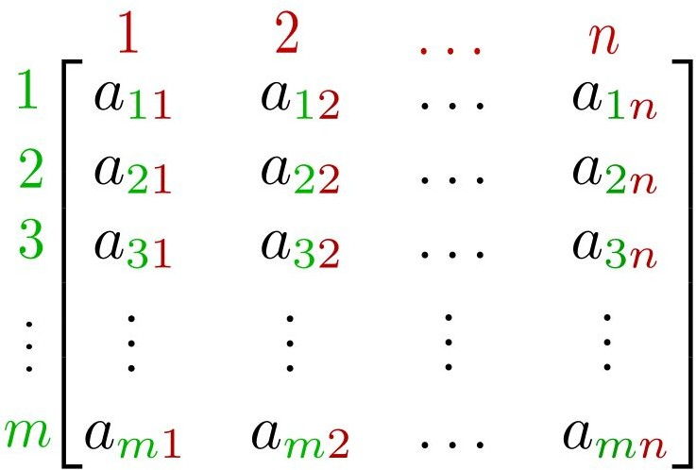
Evaluating the correspondence between representations
Multidimensional feature representation [ncol :4,096]
FEATURE MATRIX
120 images

Slide 15
Evaluating the correspondence between representations
Inner Product of Feature Matrix produces a 120x120 similarity matrix:
FEATURE MATRIX
F = [120 x 4096]
F^{T} = [4096 x 120]

Slide 16
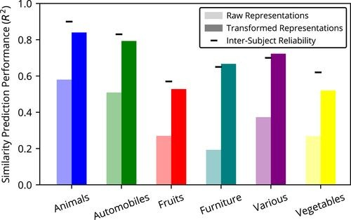
Evaluating the correspondence between representations
Results :
computing the correlation between the human similarity judgments and the inner products computed in the deep feature spaces. (both 120x120)

Slide 17
Evaluating the correspondence between representations
Results :
computing the correlation between the human similarity judgments and the inner products computed in the deep feature spaces. (both 120x120)
VGG (best performing DNN architecture)

Slide 18
Evaluating the correspondence between representations
Results :
computing the correlation between the human similarity judgments and the inner products computed in the deep feature spaces. (both 120x120)
VGG (best performing DNN architecture)
The raw deep representations provide a reasonable first approximation to human similarity judgments.

Slide 19
Evaluating the correspondence between representations
To better understand how DNNs succeed and fail to reproduce the structure of psychological representations, they applied two classic psychological tools:
non-metric multidimensional scaling
converts similarities into a spatial representation
hierarchical clustering
produces a tree structure (dendrogram)

Slide 20
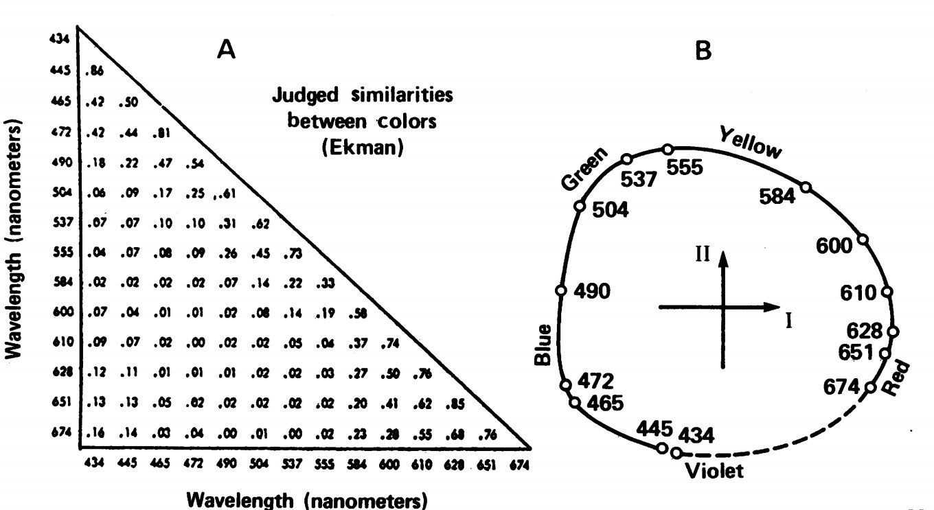
Multidimensional Scaling: from relative distances of n elements to a map of relative distances in 2* dimensions.

Slide 21
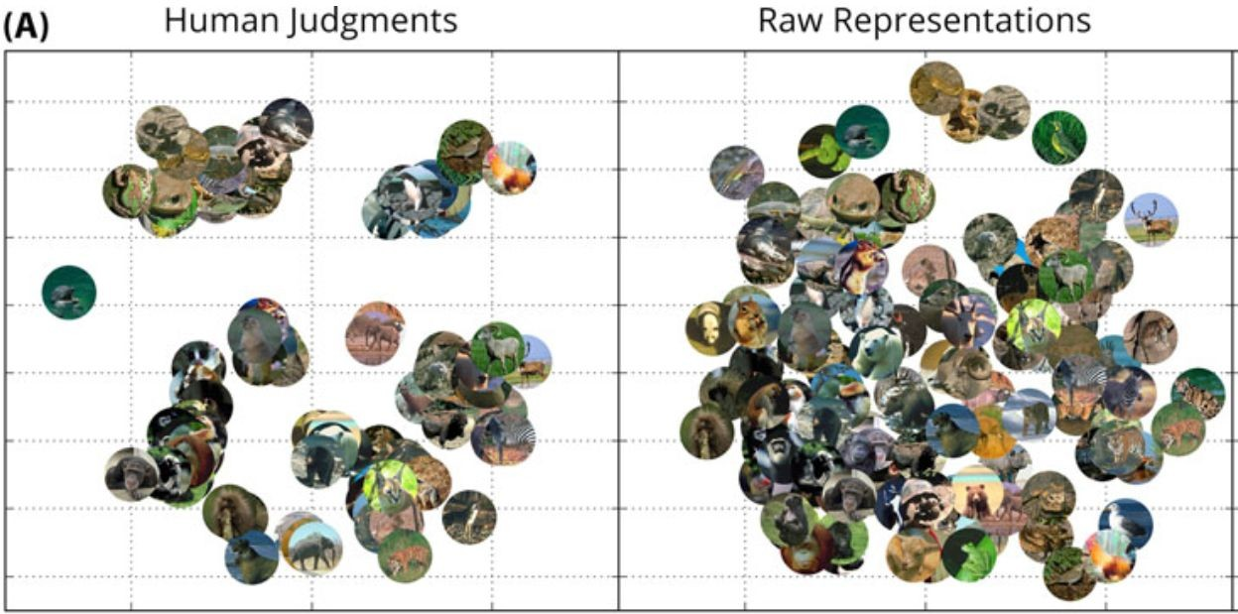
Evaluating the correspondence between representations

Slide 22
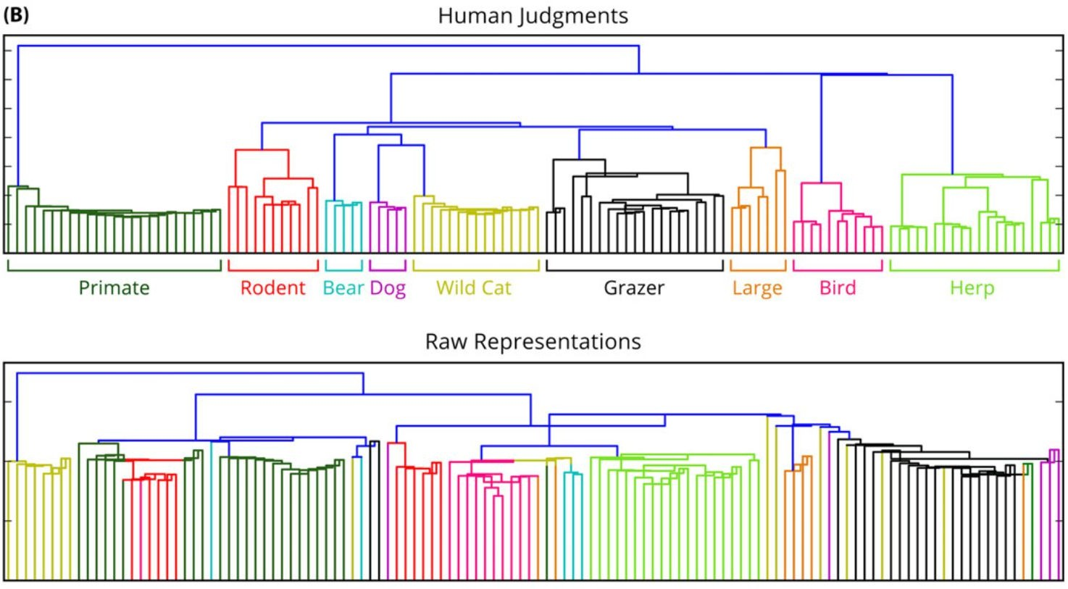
Evaluating the correspondence between representations
2. Hierarchical Clustering

Slide 23
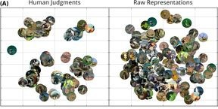
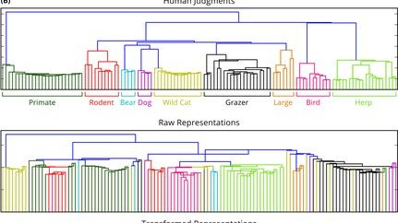
Evaluating the correspondence between representations
Human representations exhibit highly distinguished clusters in the spatial projections and intuitive taxonomic structure in the dendrograms, neither of which is present in the DNN representations.

Slide 24
Transforming Representations
how can DNN representations be transformed to increase their alignment with psychological representations?
with a set of weights on the features used to compute similarity

Slide 25
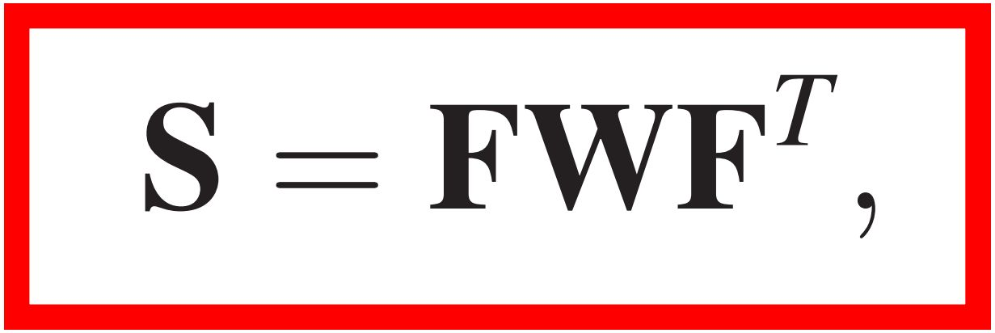
Transforming Representations
how can DNN representations be transformed to increase their alignment with psychological representations?
with a set of weights on the features used to compute similarity

Slide 26
Transforming Representations
(a diagonal matrix) of dimension weights
Similarity matrix
Feature matrix

Slide 27
Transforming Representations
It provides a way to specify the relationship between a feature representation and stimulus similarities.

Slide 28
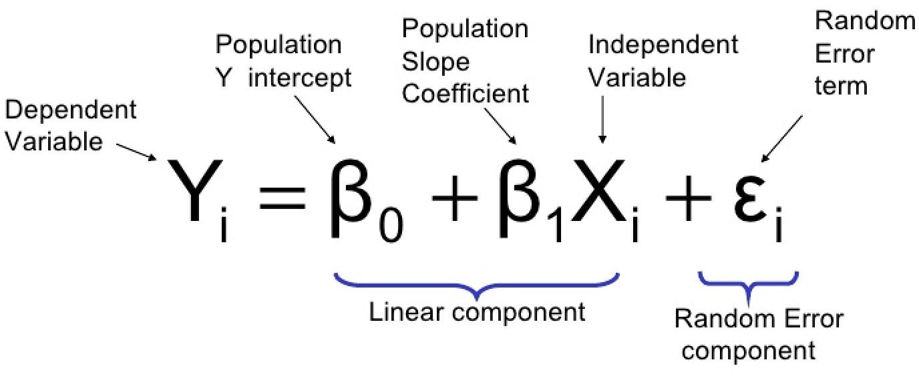
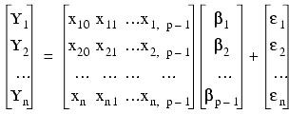
Transforming Representations
can be expressed as the solution to a linear regression problem
the predictors for each similarity sij are the (elementwise) product of the values of each feature for objects i and j
(i.e., each row of the regression design matrix X can be written as Fi∘Fj)

Slide 29
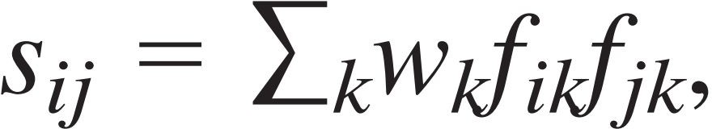
Transforming Representations
The similarity sij between objects i and j is therefore modeled as :
Weight of that feature
“k” th feature of the image “i”
Similarity between image “i” and “j”

Slide 30
Learning transformations
Freely identifying the w that best predicts human similarity judgments runs the risk of overﬁtting, since our DNNs generate thousands of features.

Slide 31
Learning transformations
Freely identifying the w that best predicts human similarity judgments runs the risk of overﬁtting, since our DNNs generate thousands of features.
L2 regularization on w
penalizing models for which the inner product w^{T}w is large

Slide 32
Learning transformations
Freely identifying the w that best predicts human similarity judgments runs the risk of overﬁtting, since our DNNs generate thousands of features.
L2 regularization on w
penalizing models for which the inner product w^{T}w is large (we want to minimize the square magnitude of weights; produces models with may small weights rather than few large ones.)

Slide 33
Improvement through feature adaptation
Trained only for the best performing Deep Neural Network, VGG
Variance Explained doubled compared to raw representations on all domains

Slide 34
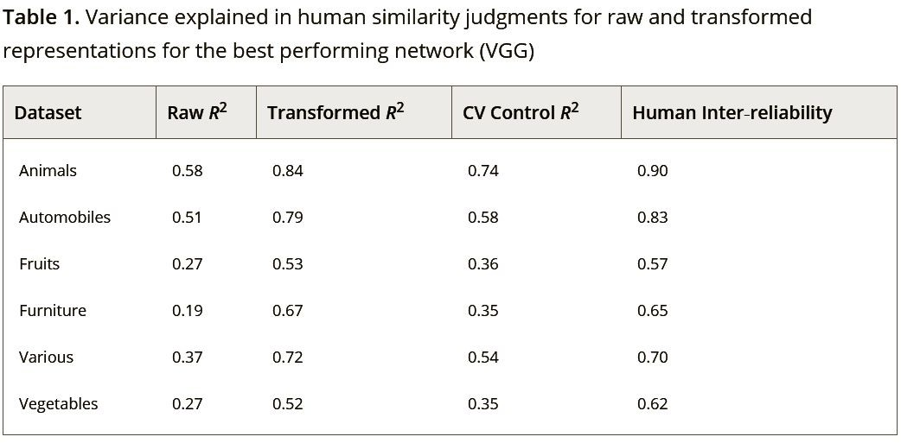
Improvement through feature adaptation
The stricter case of cross-validation titled ‘CV control’ explained the similarity judgements better than raw representations. In this case no single images occured in both training folds and test folds of cross-validation
However, for ‘Transformed model’, the exclusivity was wrt to pair of images.

Slide 35
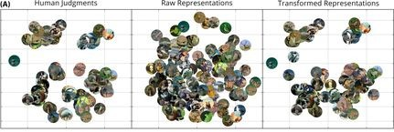
Improvement through feature adaptation
Comparison of the results from MDS :
Stronger resemblance to
human judgements

Slide 36
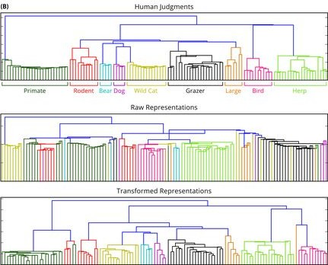
Improvement through feature adaptation

Slide 37
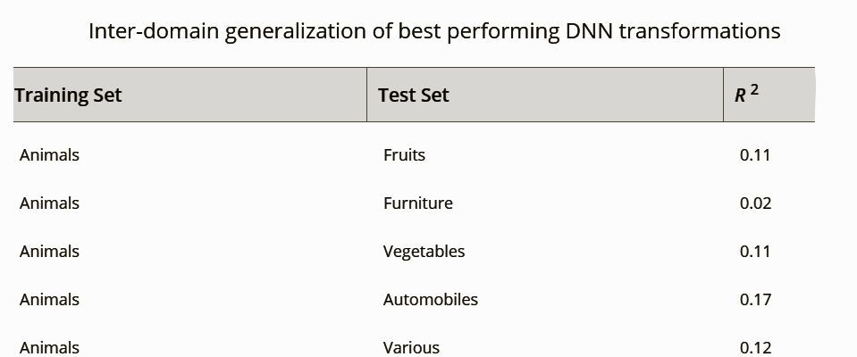
Inter-domain Transfer
Transformations learnt on one domain do not generalize to others
Correlations are poor & worse compared to those of untransformed data

Slide 38
Discussion
Raw representations from an AI system may approximate well representational space of humans, but MDS and Hierarchy show weakness.
These representations can be easily transformed to produce better human similarity predictions
These transformed models can be used to predict similarity judgements for new stimuli

Slide 39
Discussion
The simple re-weighting of features that the linear transformation performs, can be viewed as an analogue to dimensional attention.
The ability of transformed representations to generalise for new stimuli empowers studies on cognitive processes relying on such representations in the brain.

